Slide 1
Economics 144 Economic Forecasting
Lecture 5
Modeling and Forecasting Seasonality
Dr. Randall R. Rojas

Slide 2
Today’s Class
Seasonality Characteristics
Modeling Seasonality
Forecasting Seasonality
Forecasting Performance
Example: Forecasting Housing Starts
R Example

Slide 3
Seasonality Characteristics _{1 of 3}
Seasonal Pattern: Is a pattern that repeats itself every year.
Deterministic Seasonality: When the annual repetition is exact.
Stochastic Seasonality: When the annual repetition is approximate.
Sources of Seasonality: links to the calendar, technologies, preferences, institutions, etc.

Slide 4
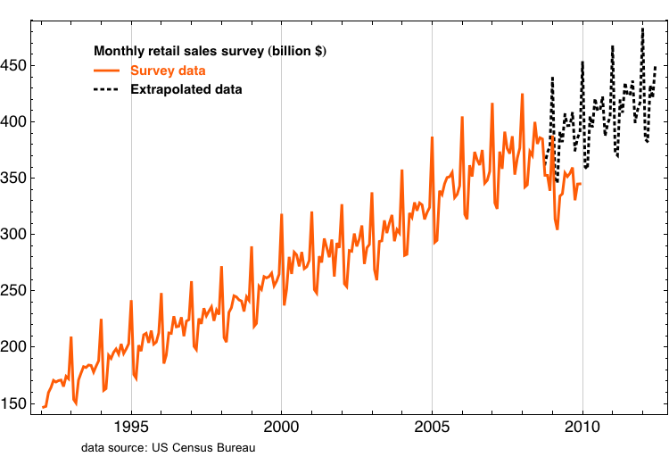
Seasonality Characteristics _{2 of 3}
US Census Bureau Data
Monthly Retail Sales (billion $)
Year

Slide 5
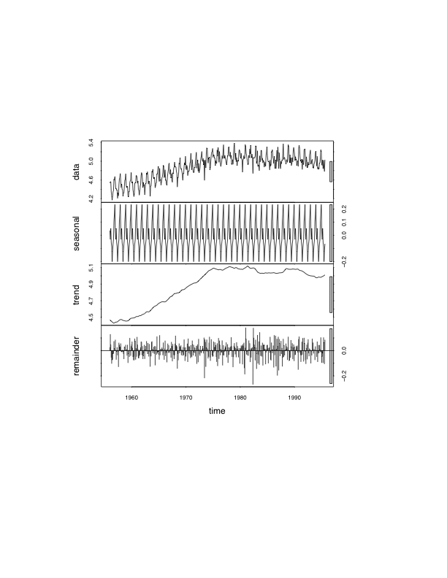
Seasonality Characteristics _{3 of 3}
Seasonally Adjustment:
Removal of seasonality.
Nonseasonal Fluctuations: Fluctuations left in the seasonally adjusted time series.

Slide 6
Modeling Seasonality _{1 of 3}
Preliminary Definitions:
s: Number of observations on a series in each year (e.g., quarterly data (s=4), monthly (s=12), weekly (s=52),…,etc.).
Seasonal Dummy Variables (D_{i}): Indicate which season we are in. For example, in the case of four seasons, we have 4
quarters:
D₁ = (1, 0, 0, 0, 1, 0, 0, 0, 1, 0, 0, 0,…)
D₂ = (0, 1, 0, 0, 0, 1, 0, 0, 0, 1, 0, 0,…)
D₃ = (0, 0, 1, 0, 0, 0, 1, 0, 0, 0, 1, 0,…)
D₄ = (0, 0, 0, 1, 0, 0, 0, 1, 0, 0, 0, 1,…)
Seasonal Factors ( γ_{i}): Summarize the seasonal pattern over the year.

Slide 7


Modeling Seasonality _{2 of 3}
Pure Seasonal Dummy Model:
Seasonal Dummy Model including Linear Trend:

Slide 8
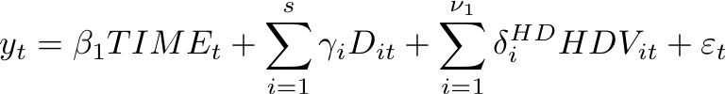
Modeling Seasonality _{3 of 3}
Seasonal Dummy Model including Linear Trend and Holiday Variation: Holidays’ dates change over time.
Seasonal Dummy Model including Linear Trend, Holiday Variation, and Trading-day Variation: Different months contain different numbers of trading days, or business days.
=1 if the month contains e.g., Easter, and =0 otherwise.

Slide 9
Forecasting Seasonality _{1 of 2}
Example (Point Forecast): Initially at T, and want to use a seasonal model to forecast the h-step-ahead value.
Assume a full seasonal model:
At time T+h:
Point Forecast: Project the right side of the equation on Ω_{T} .
Use Parameter Estimates

Slide 10




Forecasting Seasonality _{2 of 2}
Example (Interval Forecast): Same idea as before. Assume the regression disturbance is normally distributed, then:
Interval Forecast:
In practice, use:
Example (Density Forecast): Same idea, yet again!
Density Forecast:
In practice, use:

Slide 11




Forecasting Performance _{1 of 2}
Mean Forecast Error (MFE or Bias): Measures average deviation of forecast from actuals.
Mean Absolute Deviation (MAD): Measures average absolute deviation of forecast from actuals.
Mean Absolute Percentage Error (MAPE): Measures absolute error as a percentage of the forecast.
Standard Squared Error (MSE): Measures variance of forecast error.

Slide 12
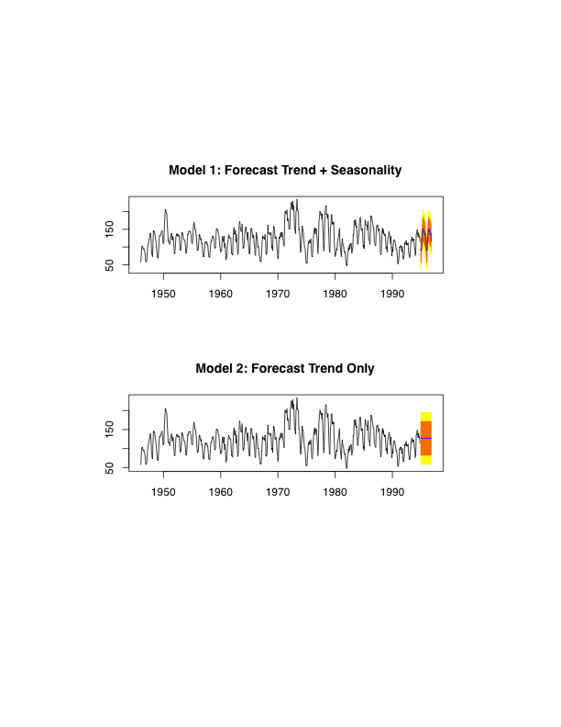
Forecasting Housing Starts _{1 of 3}

Slide 13
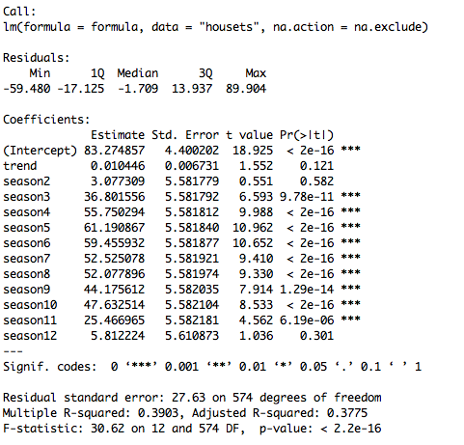
Forecasting Housing Starts _{2 of 3}
(γ_{i} )
Trend

Slide 14
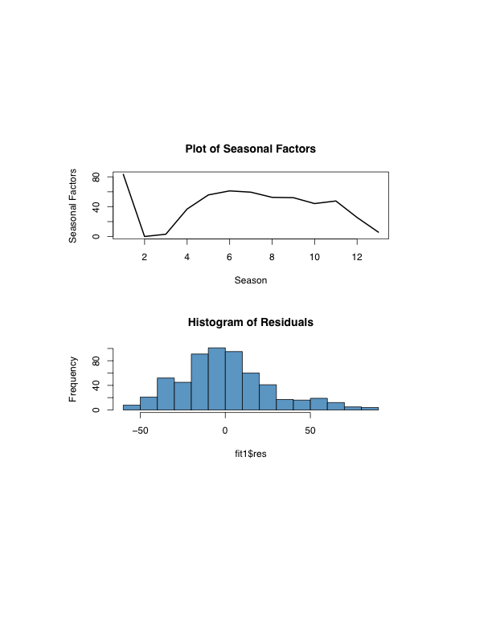
Forecasting Housing Starts _{3 of 3}
(γ_{i} )
Decline in Nov & Dec
Peak at May
Low seasonal effects in Feb
Residuals

Slide 15
For Next Class
Readings about today’s class:
Chapter 6^{b}, Problems 6, 7, 9
Review Exercises / Problems:
Chapter 6^{b}: 2, 3, 4
Readings for next class:
Chapter 7^{b}: Characterizing Cycles

